Slide 1
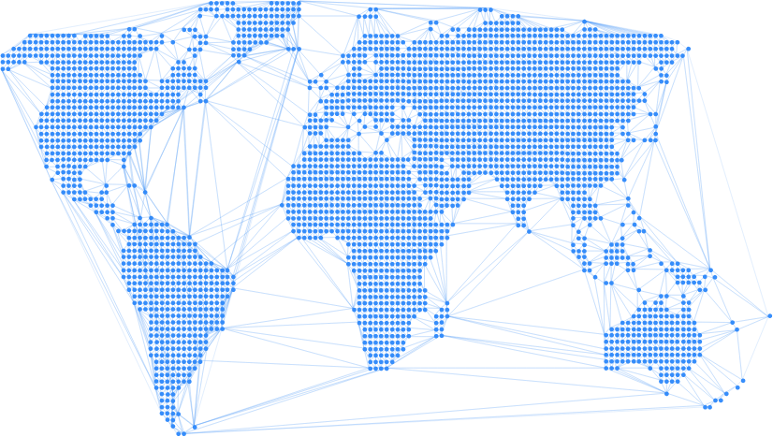

Enable
Creating opportunity through peer-to-peer stablecoin loans

Slide 2
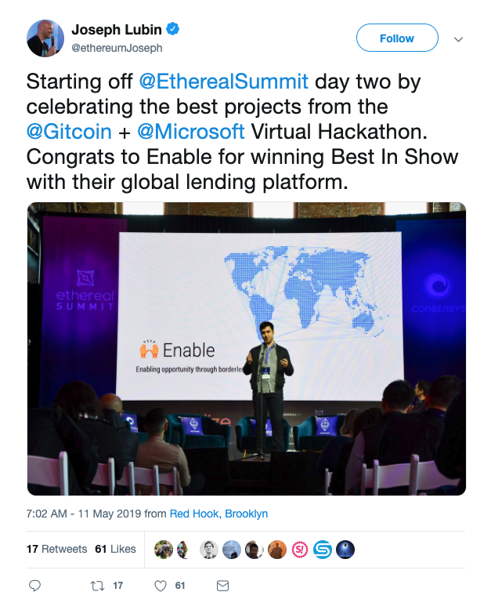
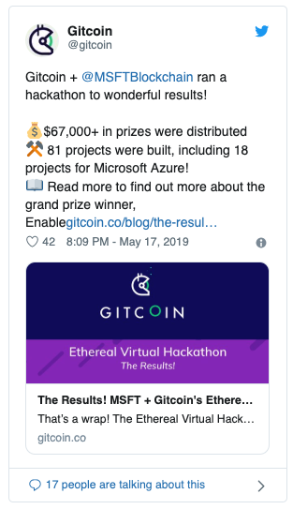
How we started

Slide 3

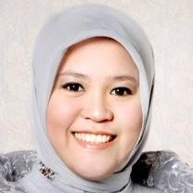
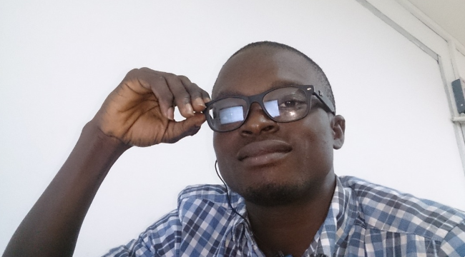



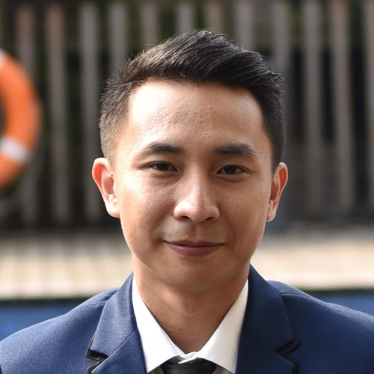
Today:
Supported by $15k grant:
6 volunteers across the globe Building a “Kiva for Dai”
Anthony
Ines
Daniel
Thomas
Faisal
Felix

Slide 4
Ines’ story
Real World DeFi

Slide 5
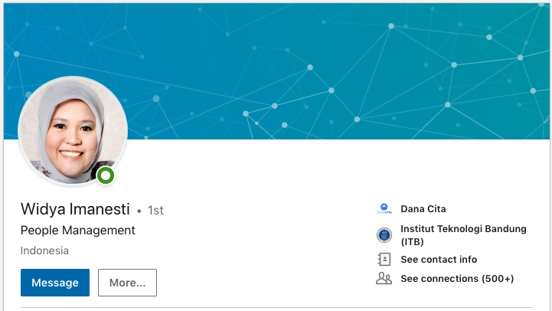
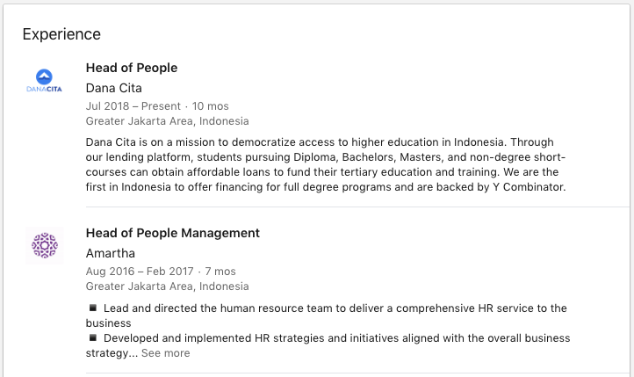
Ines’ Story
Background Executive in Indonesia (Head of HR), with credit history in Indonesia
Family Husband is also from Indonesia, currently doing a PhD in the US
New York Cornell University, Masters in HR US$60,000 due on August 23rd

Slide 6
Ines’ Story
$60,000 due Aug 23rd Cornell University, Masters in HR
High domestic interest rates Secured: 9.9% - 12.5%
Unsecured: 17% - 30+%
Inflation: 2.5-2.57%
Indonesia
No access to capital No low-interest rate federal student loan programs, private and state-owned banks only tend to give out small loans (<$3,000) and don’t fund $60,000 loans over 10 years unless it’s a mortgage or commercial loan
Lender’s Fees Traditional lenders charge origination fees (3-5% of loan amount) on top of interest to cover their operations. For a $60,000 loan, that’s $3,000.

Slide 7
Ines’ Story
$60,000 due Aug 23rd Cornell University, Masters in HR
Cost of sending money to the US Domestic-US bank fees and hidden “forex” chargescan amount up to 1-2% or more. For a $60,000 loan, that’s $600
Indonesia

Slide 8


Ines’ Story
$60,000 due Aug 23rd Cornell University, Masters in HR
Immigrants have no credit history Credit score and financial reputation in Indonesia doesn’t follow Ines to the US, despite being an executive in Indonesia
Indonesia
Current Solution:
Cross-border lenders (Mpower, Prodigy)
11.99% p.a. interest for $60,000, 10 year loan term (total: $103+k)
5% origination fee (i.e. $3,000)
Only funds $25,000 out of $60,000

Slide 9
What we’re building
Peer-to-peer “social credit” based lending

Slide 10


Reputation as collateral
Mimicking informal systems of trust in emerging markets
Philippines Lenders will hold ATM cards of borrowers and their PIN as “collateral”
Cambodia Multi-finance companies make loans public if borrower cannot post collateral
Unable to put up collateral Insufficient current wealth to buy and hold crypto
DeFi Space? What would ”reputation-as-collateral” look like in the DeFi space?

Slide 11



Identity
Sybil-resistant on-chain identities are still in nascent phases
Interim Solution: Seek borrowers whose professional identities matter and are incentivized to establish creditworthiness

Slide 12
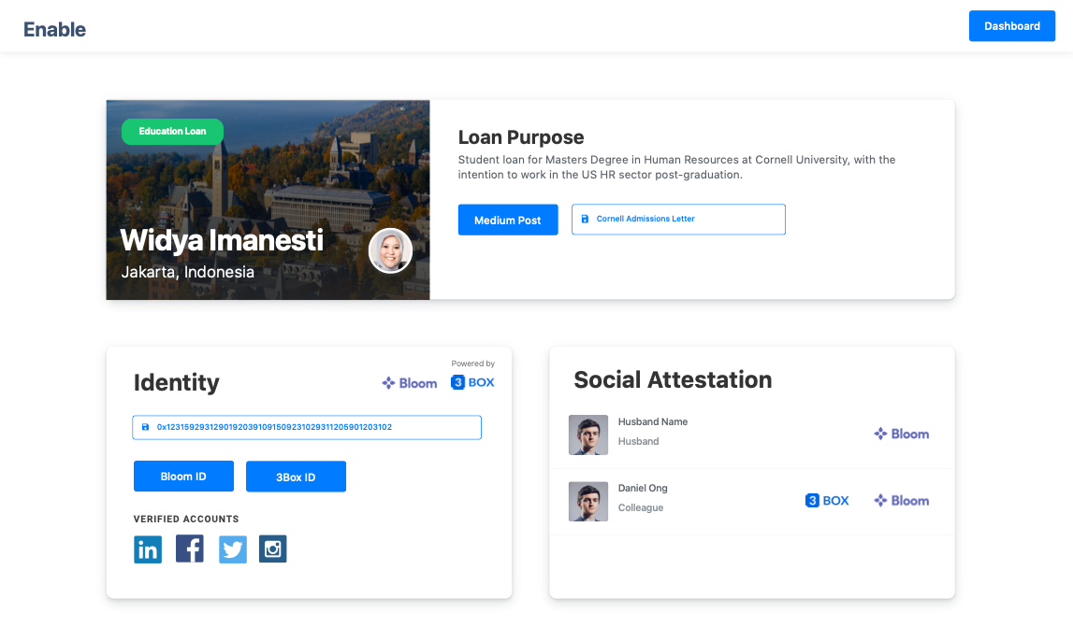
Social Credit as collateral
Utilizing social proof and social pressure as collateral
Identity-as-collateral
Creating a on-chain identity tied to real-world identity allows unsecured lending with identity as collateral
Social Attestation
Other verified identities can attest for borrower, develop a richer credit profile

Slide 13
Find prime but underserved borrowers
Providing financial services to higher quality borrowers
“Credit is fundamentally broken when crossing borders” Cameron Stevens Founder, Prodigy Finance
Legal Immigrants have no credit history Credit score and financial reputation in Indonesia doesn’t follow Ines to the US, cannot take a loan there
Value Creative Loans Focus on funding value-creative loans (vs. consumptive loans) such as education, working capital, entrepreneurial loans

Slide 14
Our progress so far
60,000 Dai fundraise for Ines in late August

Slide 15
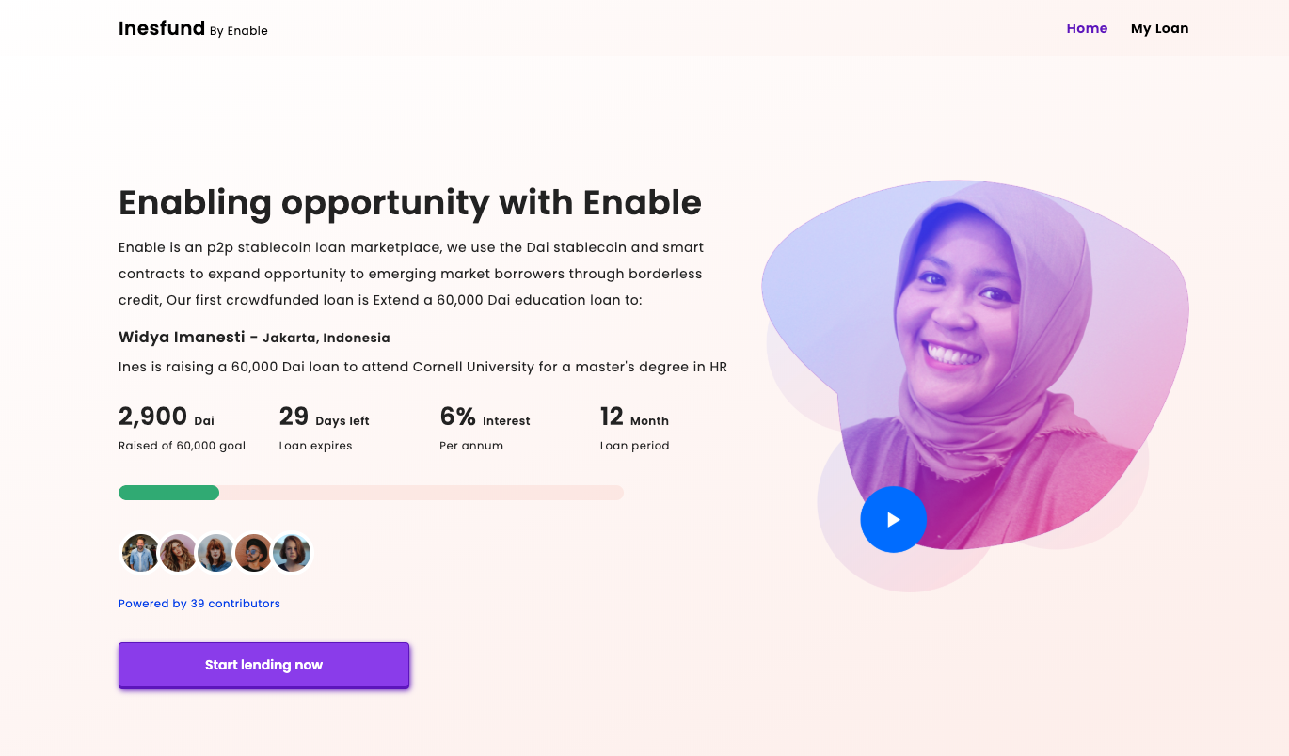
Invest in Ines
60,000 Dai fundraise for Ines in late August

